Slide 1
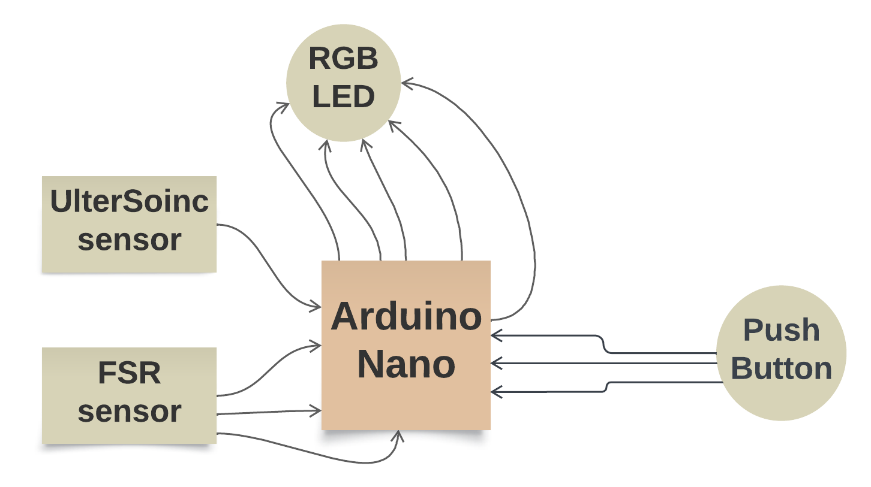
Block Digram Design 1

Slide 2
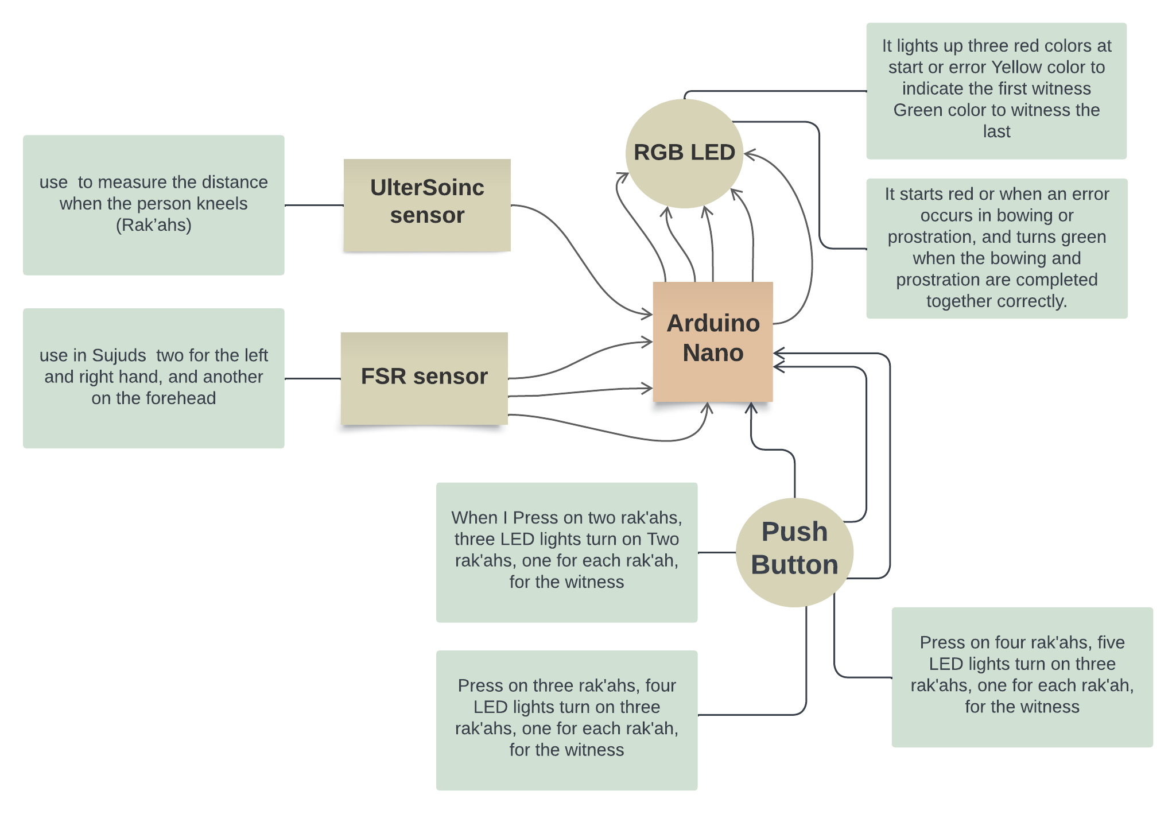
Block Digram Design 2

Slide 3
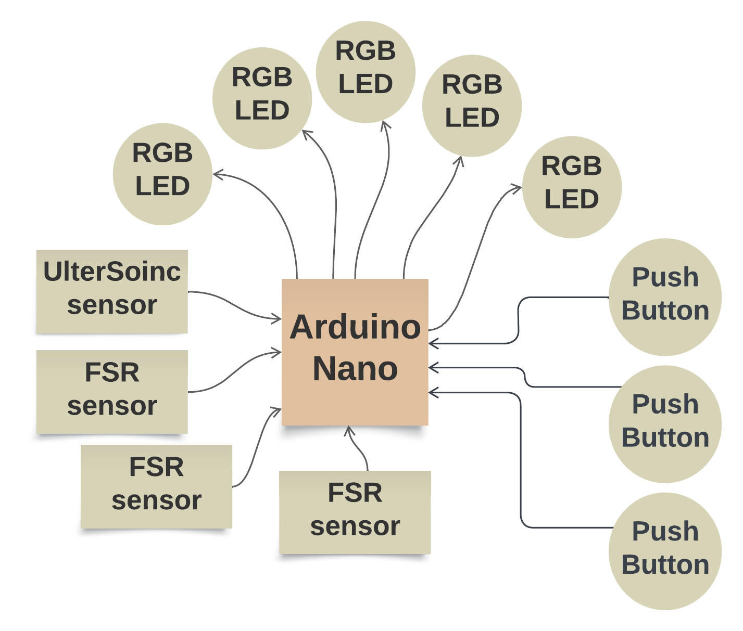
Block Digram Design 3

Slide 4
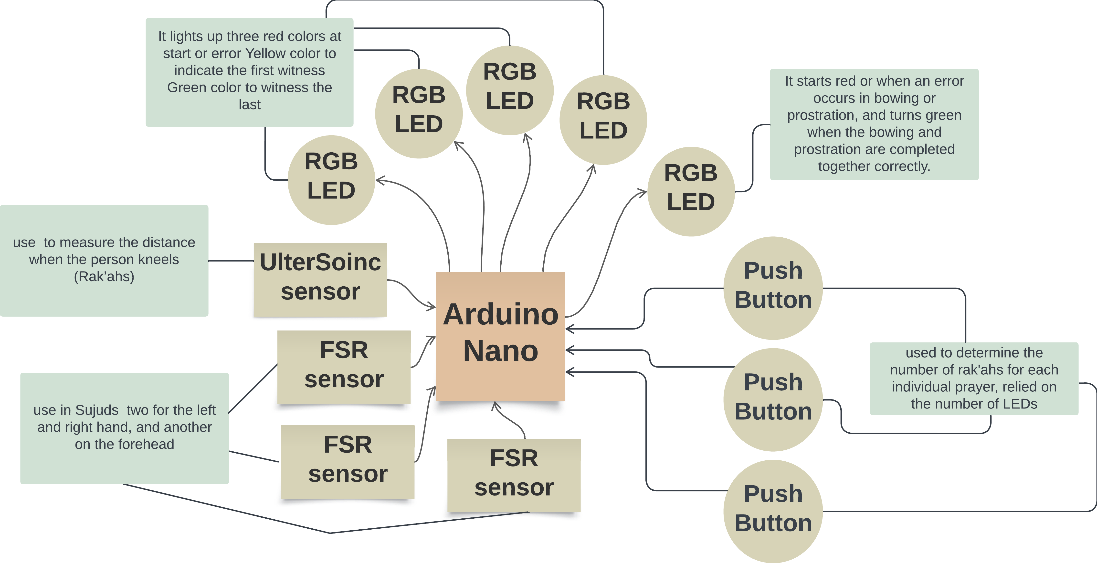
Block Digram Design 4

